Slide 1



SUNDAY
Sunday Bloody Sunday -
U2
Aymeric
SORT
Alex
GARIN
BLOODY
SUNDAY
SUNDAY

Slide 2



Sunday Bloody Sunday
Aymeric
SORT
Alex
GARIN
SUMMARY
01
General Presentation
02
The Context
03
A protest song
04
Our Impression

Slide 3


Sunday Bloody Sunday
Aymeric
SORT
Alex
GARIN
GENERAL PRESENTATION
Realease date:
21 March 1983
Compositor:
Steve Lillywhite
Type of music:
Pop Rock
About The Group
U2 is an Irish rock band from Dublin, formed in 1976.

Slide 4
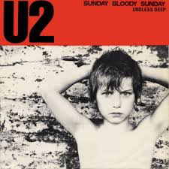
Sunday Bloody Sunday
Aymeric
SORT
Alex
GARIN
THE CONTEXT
This iconic song by U2 was released in 1983 and reflects on the tragic events of "Bloody Sunday", which occurred in Derry, Northern Ireland, on January 30, 1972. On that day, British soldiers shot unarmed protesters during a civil rights march, killing 14 people.
The song combines themes of political conflict, human suffering, and a call for peace, making it a powerful anthem against violence and injustice.

Slide 5


Sunday Bloody Sunday
Aymeric
SORT
Alex
GARIN
A PROTEST SONG
Causes Defended
The song opposes violence, highlights the fight for civil rights, and calls for peace amid political conflict in Northern Ireland.

Slide 6

Sunday Bloody Sunday
Aymeric
SORT
Alex
GARIN
OUR IMPRESSION
01
.Powerful Message
Emotional Impact
Musical Strength
Global Influence
02
03
04

Slide 7

Sunday Bloody Sunday
Aymeric
SORT
Alex
GARIN
THANK
YOU

